Slide 1
Extraction of adverse drug reaction from unstructured data
Authors:-
-Suman Chatterjee,Dual degree(cse) final year.

Slide 2
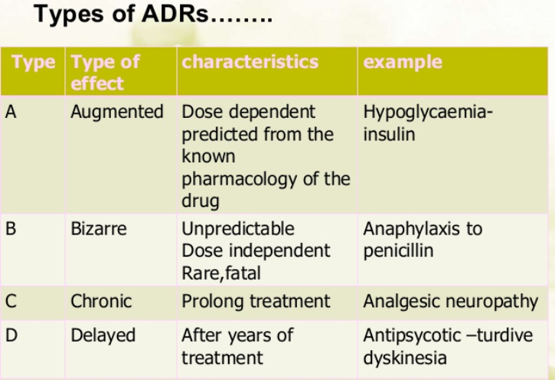
Introduction
Pharmacovigilance is defined as “the science and activities relating to the detection, assessment, understanding and prevention of adverse effects or any other drug problem” (World Health Organization and others, 2002).
Patients are often subject to multiple treatments, which may be the cause of adverse effects. Therefore, it is necessary to establish if an Adverse Event (AE) has occurred after taking medicines.

Slide 3
What is adverse drug reaction?
AE refers to any unwanted or harmful effects experienced occurring at the time a drug or a combination of drug is used, whether it is identified as a cause of the event or not. In case one can establish a relation between the AE and the drug, then the relation is considered as an Adverse Drug Event (ADE) or Adverse Drug Reaction (ADR).
Eg:1. A person taking a drug to reduce high blood pressure may feel dizzy or light-headed if the drug reduces blood pressure too much.
2. A person with diabetes may develop weakness, sweating, nausea, and palpitations if insulin or an oral antidiabetic drug reduces the blood sugar level too much.

Slide 4
How to identify ADR ?
For the purpose of identifying ADE mentions, we use medical notes provided in EHR (Electronic Health Records). These notes contain mentions of medical entities like medications, ADE (Adverse Drug Event) and symptoms. These terms have to be identified and classified in the right category.
But This process can be both error-prone and labor-intensive. Automating it is essential to developing an effective EMR infrastructure. Natural language processing (NLP) techniques have demonstrated successes within the clinical domain.
The goal is the development of a large-scale, comprehensive, modular, extensible, robust, open-source NLP system designed to process and extract semantically viable information to support the heterogeneous clinical research domain and to be sufficiently scalable and robust to meet the rigors of a clinical research production environment.

Slide 5
History and previous works
FDA uses the Adverse Event Reporting System (FAERS) to detect adverse events. FEARS includes mandatory reports from pharmaceutical companies and reports that have been submitted to MedWatch directly. The current approach for FEARS case report review requires manual reading of the text of the drug labels in order to determine whether a candidate ADR has been reported before or not.
Lipton trained Long Short-Term Memory networks (LSTMs) to classify 128 diagnoses from 13 frequently but irregularly sampled clinical measurements from patients in pediatric ICU. Razavian(2016) used LSTMs to predict onset of 133 diseases and conditions simultaneously based on 18 common lab tests measured over time. They showed that the LSTM learned representations outperformed a logistic regression baseline with hand engineered features. Pham (2017)used LSTMs to model the longitudinal records of diagnoses, medications and procedures and made dynamic predictions of future diagnoses, medications and procedures. They showed improved performance over competitive models including SVM.
For unstructured clinical data, Dernoncourt (in 2016)applied bi-directional LSTMs to de-identifying patient notes. They adopted two bi-directional LSTM layers, one at character level and the other at word level. Their character level embedding and LSTM aim to address data sparsity due to out-of-vocabulary tokens, misspellings, and different noun forms or verb endings. The two layer bi-directional LSTMs showed improved de-identification performance from state-of-the-art Conditional Random Field (CRF) models.

Slide 6
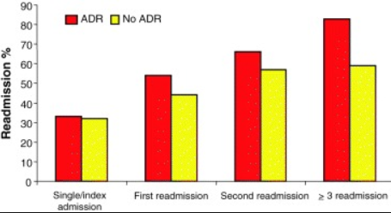
Impact:Why should it be implemented?
The Federal Drug and Administration (FDA) shows the patients with ADRs have double length of stay and mortality than those of non-ADR patients. Moreover, up to 39% of ADRs in pediatric inpatients can be life-threatening or fatal. A study estimated that between 32% and 69% of drug-related admissions could be potentially preventable.In the U.S., the cost of ADRs may be up to $136 billion annually.
Many ADRs are hard to discover as they happen to certain groups of people in certain conditions and they may take a long time to expose.
Healthcare providers conduct clinical trials to discover ADRs before selling the products but normally are limited in numbers. Thus, post-market drug safety monitoring is required to help discover ADRs after the drugs are sold on the market.
Recently unstructured data such as medical reports or social network data have been used to detect content that contains ADRs. Case reports published in the scientific biomedical literature are abundant and generated rapidly. Social networks are another source of redundant data with unstructured format. While it may contain ADRs that not be clinically useful, a large volume of these data can expose serious or unknown consequences.
Our system will help in automation of the extraction of the ADRs from drug labels which would increase the efficiency of discovery, which will in turn can save millions of lives.

Slide 7
Data
The Twitter ADR Dataset is divided into train and test sets.For each set of information about the tweets and annotation are saved in different files:
Tweet ID and Annotation files.
Tweet ID Files:train_tweet_ids.tsv,test_tweet_ids.tsv.The files have tab separated information about tweet IDs,user IDs and test IDs as shown in the information below.
346546465465465 68769687 10238
The Tweet ID and user ID can be used for downloading the tweets. The test ID links to the corresponding annotations in the annotation file.
Annotation Files: train_tweet_annotations.tsv, test_tweet_annotations.tsv
These files contain tab separated information about the details of the annotations including: text ID, start offset, end offset, semantic type, annotated text, related drug and target drug. The following line is an example annotation line. Please note that the related drug is the (properly spelled) drug that was used as a keyword in Twitter search query and the target drug is the drug that the current annotation (ADR or Indication) is targeting. Target drug can be different from the related drug in cases where there are more than one drug mentions in a tweet.
10238 13 34 ADR Restless Leg Syndrome fluoxetine fluoxetine

Slide 8
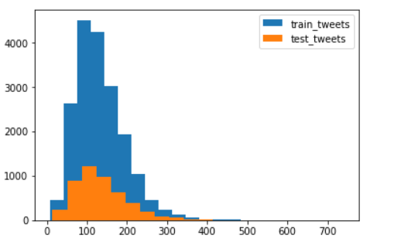
Methods:How can it be implemented?
Preprocessing
Sentence boundary detector
Tokenization
Normalization
Part of Speech Tagging
Shallow Parser
Named Entity Recognition
Information Extraction
Feature Extraction Models
Combined Word Embedding-Character level and Word Level
Classification
Bidirectional-LSTM model
1-CNN layer with dropout technique for reducing overfitting.
Evaluation Metrics and Significance test
Training & Hyperparameters

Slide 9
Preprocessing
We use the SpaCy Library for preprocessing which excels at large-scale information extraction tasks.
We first preprocessed the training dataset in 7 steps: (1) sentence partition, (2) stop words removal, (3) tokenization, (4)Normalization and (5) part-of-speech (POS) tagging.
Sentence Boundary Detector-It predicts whether a period, question mark, or exclamation mark is the end of a sentence.
Tokenization-Segmenting text into words, punctuations marks etc.
Normalization-provides a representation for each word in the input text that is normalized with respect to a number of lexical properties. Normalization makes it possible to map multiple mentions of the same word that do not have the same string representations in the input data.
Part-Of-Speech Tagging-Assigning word types to tokens, like verb or noun.
Shallow parsing is an analysis of a sentence which first identifies constituent parts of sentences (nouns, verbs, adjectives, etc.) and then links them to higher order units that have discrete grammatical meanings (noun groups or phrases, verb groups, etc.).
Named-Entity Recognition-Labelling named "real-world" objects, like drugs,diseases,etc..

Slide 10
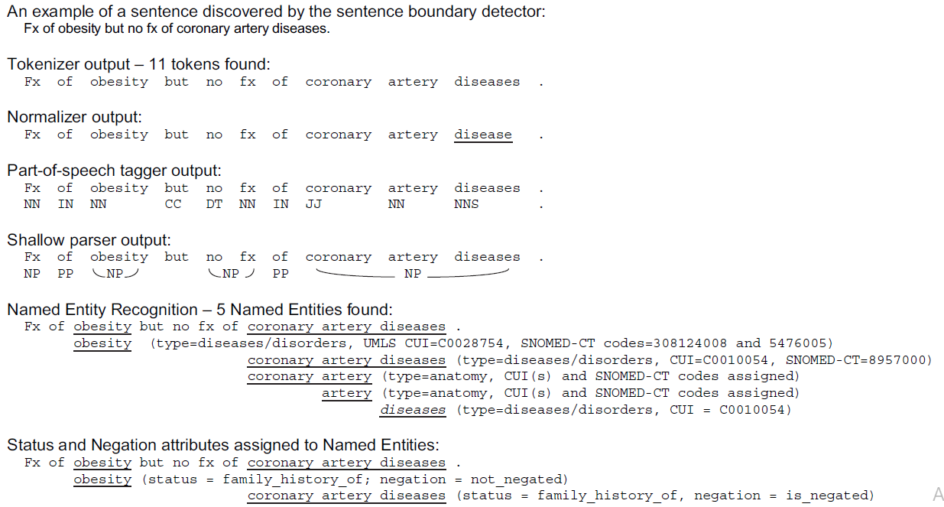
Example of sentence preprocessed:

Slide 11
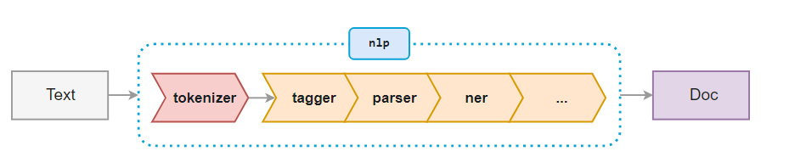
Pipeline for pre-Processing:

Slide 12
Information extraction:Combined Word EMbedding
For NLP applications, recurrent neural network models are most used together with word embeddings.
The word embedding is designed to capture semantic similarity of words. The embeddings are meaningful real-valued vectors of configurable dimension, and semantically similar words usually have close embedding vectors.
Neural language modeling tools such as word2vec can learn embedding vectors from an unlabeled large text corpus, based on the word’s context in different sentences.
For word embedding, we experimented with pre-trained word vector on general domain corpus and in-house-trained word vector on clinical notes from MIMIC-III database using word2vec tool.
The character embedding were generated by a convolutional neural network (CNN) that runs over the characters of a given token.
The character level embedding and LSTM aim to address data sparsity due to out-of-vocabulary tokens, misspellings and different noun forms or verb endings.

Slide 13
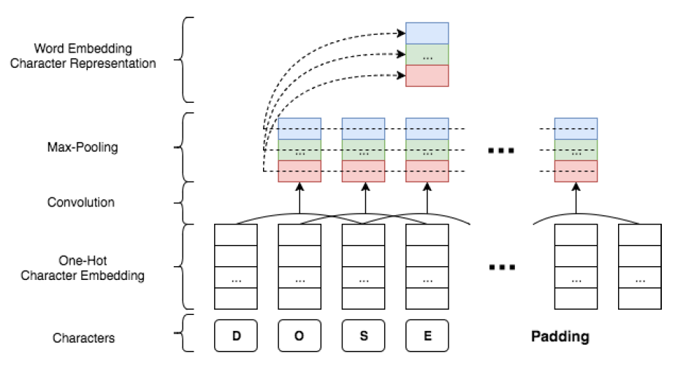
Character representation generation with cnn and word embedding.

Slide 14
Classification:Bidirectional-lstm model
RNN is a neural network architecture designed to handle input sequences of variable sizes, but it fails to model long term dependencies.
LSTM is a type of RNN that mitigates this issue by keeping a memory cell that serves as a summary of the preceding elements of an input sequence. It also handles the gradient vanishing problem better than the vanilla RNN.
A bidirectional LSTM consists of a forward LSTM and a backward LSTM, where the forward LSTM calculates the forward hidden states and the backward LSTM calculates the backward hidden states by feeding the input sequence in the backward order.
Depending on the application of the LSTM, one might need an output sequence corresponding to each element in the sequence, or a single output that summarizes the whole sequence.

Slide 15
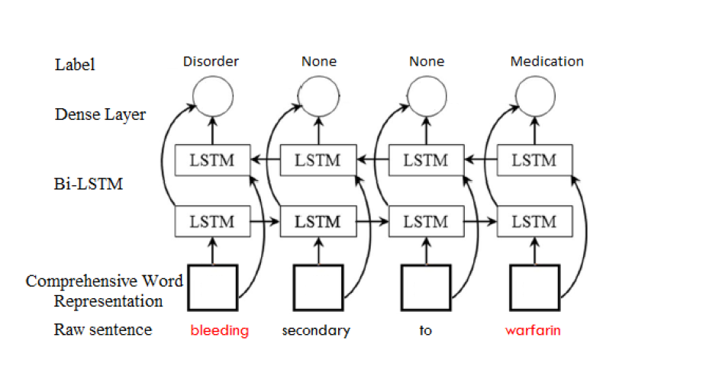
Bidirectional-lstm model:LSTM network for tagging

Slide 16
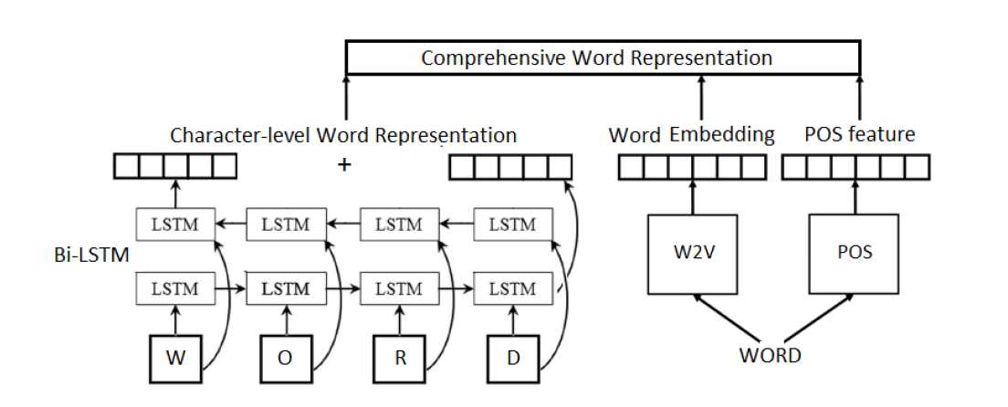
Bidirectional-lstm model:comprehensive word representation

Slide 17
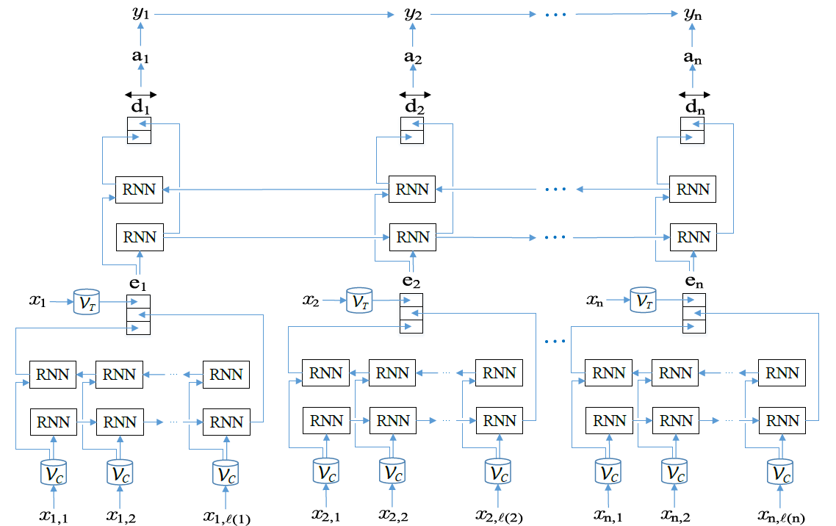
Bidirectional-LSTM with word embedding

Slide 18
Classification:Convolutional neural network
The network starts with a convolutional layer with Rectified Linear Units (RLUs). A RLU takes an input and returns the original input if it is larger than 0, otherwise, it returns 0.
The convolutional filters normally have the same width as the word vectors, thus, produce feature maps with only 1 column.
The network is then stacked by a max pooling layer that picks the maximum element from each column.
The last layer is a feedforward layer to an output layer with either sigmoid or softmax activations depending on whether the classification is binary or multinomial.

Slide 19
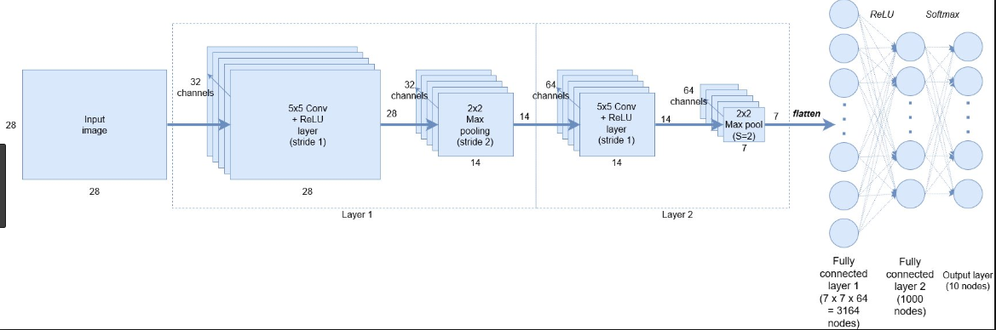
Diagram OF CNN to be used:

Slide 20
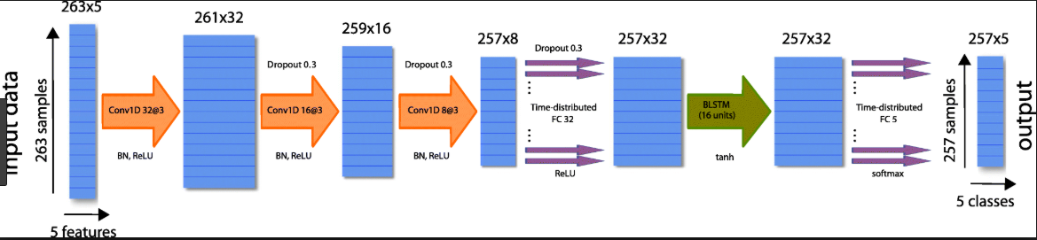
CNN applied along with bi-lstm:

Slide 21
Challenges in lstm model:
For RNNs such as LSTMs, overfitting may be a serious problem.
To address such a problem on sentence LSTM and other LSTM models developed in this study, we used the dropout technique to randomly drop the values of a portion (50% in our experiment) of hidden units in the output of the pooling layer during training.
Dropout prevents co-adaptation of these hidden units by sampling from an exponential number of different ‘‘thinned” networks, thus reduces overfitting and leads to significant improvements over other regularization methods.

Slide 22
Evaluation metrics:
To assess the performance of the two models, we computed the precision, recall, and F1-score. Let TP be the number of true positives, FP the number of false positives, and FN the number of false negatives. Precision, recall, and F1-score are defined as follows: precision = TP/TP+FP
Recall = TP/TP+FN ,
F1-score = 2*precision*recall /precision+recall .
Intuitively, precision is the proportion of the predicted drug labels that are ADR labels, recall is the proportion of the ADR labels that are correctly predicted, and F1-score is the harmonic mean of precision and recall.

Slide 23
Hyper-parameters:
Character embedding dimension: 25
Character-based token embedding LSTM dimension:25
Word embedding dimension: 100
Label prediction LSTM dimension: 100
Dropout probability: 0.5

Slide 24
Workflow description
Input
Discharge Summaries
Preprocessing
Sentence splitting
Information Extraction
Feature extraction
Tokenization
Normalization
POS tagging
Named entity Recognition
Word Embedding
Classification
Post Processing
Evaluation
Overfitting reduction
Electronic Health Reports
Social Network Data
Output
P(ADR|Sentence)
P(ADR|Tweet)
P(ADR|Data)

Slide 25
Technology stack:
Scripting Language-Python
Framework- Tensorflow.
Libraries- SpaCy,numpy,keras,sklearn
Editor- Jupyter,Spyder.
Platform-Anaconda
Datasets-Twitter ADR Dataset.

Slide 26
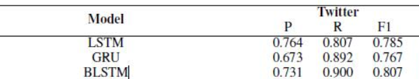
Conclusion
In this work, we use Bi-directional LSTM model for classification and 1-D CNN for faster performance. The models use simple word and distance embedding as features and higher-level feature representations.We can add neural attention mechanism to achieve higher-level feature representation.Even with the simple architecture and without any use of any complex tool based linguistic features,models produce a reasonable performance compared to some of the recently introduce neural network based approaches.This study will also discuss comparision of methods on multiple characteristics.
Analysis of the results indicates the following important points: imbalance and noise affect all models adversely, the Advice interaction class is the easiest to predict, repetitive mentions of other drug names affect all models negatively, and models are more likely to conduct incorrect classifications in longer sentences.

